Slide 1
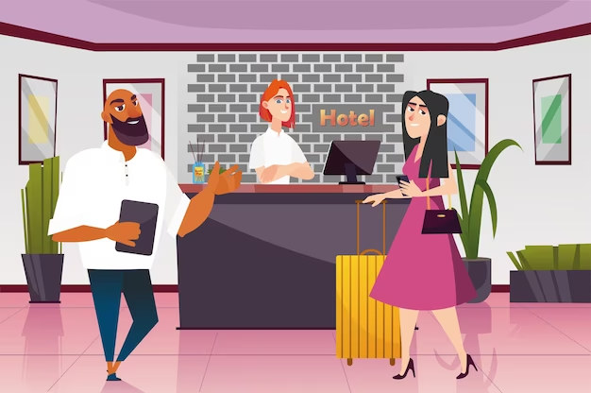
EXPERIENCE DESIGN AND MANAGEMENT

Slide 2
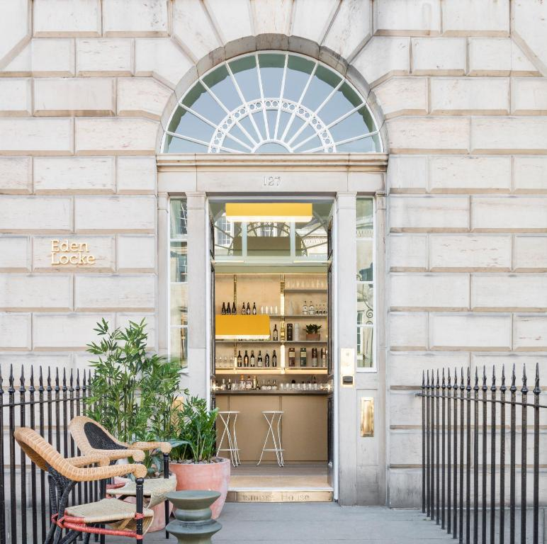
Introduction
The scenario shows that the managing director has been given responsibility in building an accommodation package
In this assignment, the accommodation package of Eden Locke boutique hotel will be designed
Notes:
In the current assignment, the scenario shows that the managing director of Eden Locke Hotel had asked the management team in preparing a theme with attractive features and benefits. The package is designed in such a manner that it will appeal to the Hotel’s main market segments. A theme will be considered and a target audience will be chosen for which Eden Locke’s boutique services will be promoted. Moreover, a theory will be considered on the marketing process.

Slide 3
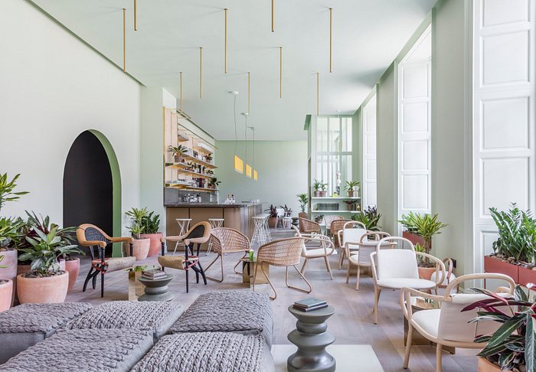
Overview of Eden Locke Hotel
The hotel is established in the year 2017
The hotel provides check-in time at 4 PM and check-out time at 11 AM
The hotel almost has 7 floors in its building
Notes:
Eden Locke is an independent hotel in the UK that was established in the year 2017 as the hotel is independent it provides its own check-in time at 4 PM and check-out timing is 11 AM. The hotel has almost 7 floors with well-furnished rooms. Involvement of a better-structured hotel is illustrated and achieved with the efficiency and integration that involves the wider concepts and provides involvement of different strategies that can be initiated to maintain the hotel’s decorum.

Slide 4
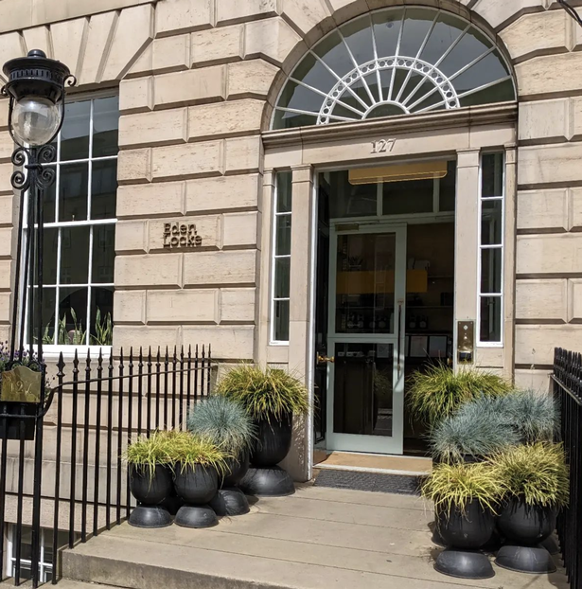
Accommodation package of Eden Locke Boutique Hotel
A boutique hotel is a kind of hotel which is small and cost-friendly
It has 75 rooms and remains aligned with the local culture
The boutique consists of a stylish bar or lounge arena
Notes:
One of the key features of Eden Locke’s Boutique Hotel accommodation package is free pickup and drop services from the airport. Moreover, while celebrating the five years anniversary, Eden Locke’s management arranges free transportation for sightseeing for the guests. Moreover, the hotel has seven floors with well-furbished 75 rooms. Besides, the considered boutique has a stylish lounge area.

Slide 5
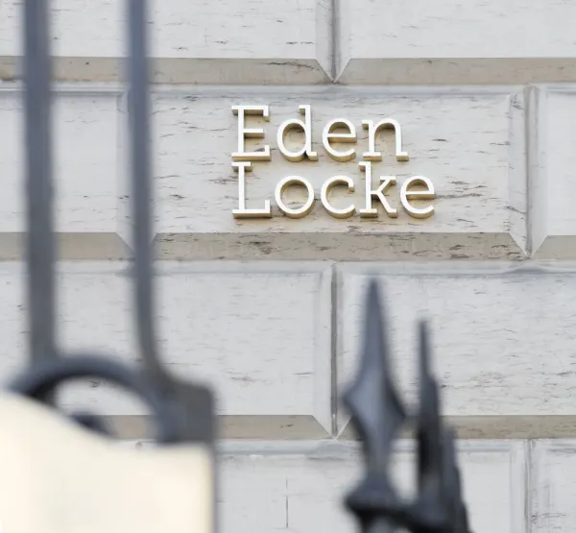
The theme of the hotel
Eden Locke was established in 2017.
For celebrating the 5 years of the journey, the company has introduced an exciting package.
The package is only for the couple.
Notes:
Eden Locke, a UK-based hotel has introduced an exciting theme for its customer base of the age group 18-30. As the company was established in 2017 and has successfully completed its 5 years journey, the company has introduced a special theme for celebrating its huge success. However, the package is only available for couples who want to enjoy a good travel experience in the country.

Slide 6
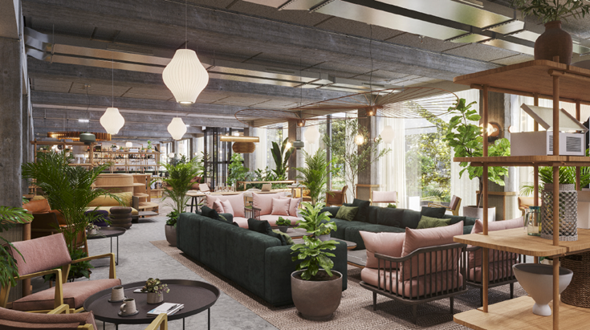
Overview of the theme
For celebrating its success the company has introduced an exciting limited-time package.
The package includes mandatory pickup and drop services.
Mandatory breakfast and dinner included.
Free transportation for sightseeing in Edinburgh city.
Notes:
The hotel has introduced an exciting limited-time package for the couple. The package includes free pickup and drop services. Mandatory breakfast and dinner are included in the package. In addition to it, dedicated service and employees for each couple are also included in the package. The company is also offering free transportation for sightseeing. Free Spa treatments for couples and free a candle night dinner will also be arranged from the management side for the couple.

Slide 7
Additional features and benefits of the theme
One of the benefits of the considered theme is it will enhance customer satisfaction
The free pickup services for the customers will lead to a positive brand image
The package will be exclusively for young couples
Notes:
One of the features of the considered theme is the facility of free sightseeing will create a perception among the customers that they may enjoy tourism with hospitality. Additionally, the feature of the “free pick-up service” will enable saving the travelling costs for guests. Apart from this, since the package also included mandatory breakfast and lunch, hence it will help in cost reduction on availing for food and beverage services from outside restaurants. The company is willing to give the international couples a smooth experience of travelling in the city.

Slide 8
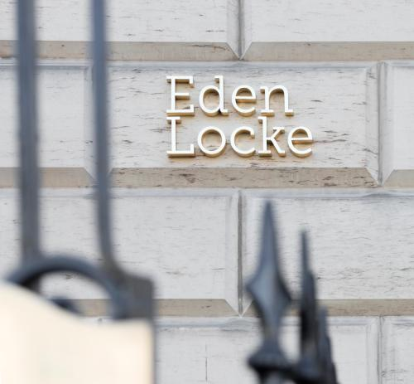
Critical Consideration and Justification of the Target Audience
The target audience for the company is the couple.
The age range is 18-30.
Notes:
In order to celebrate its success, the company has introduced an exciting package. The target audience for this package is couples who are visiting Edinburgh City. The age requirement for this package is 18-30. One of the reasons for which the age group is chosen since mainly the individuals of this age visit the boutiques to the enhancement of their tourism experience. Moreover, since the income may not be as high for younger couples, hence low-cost boutique can be affordable for them in spending a short vacation.

Slide 9
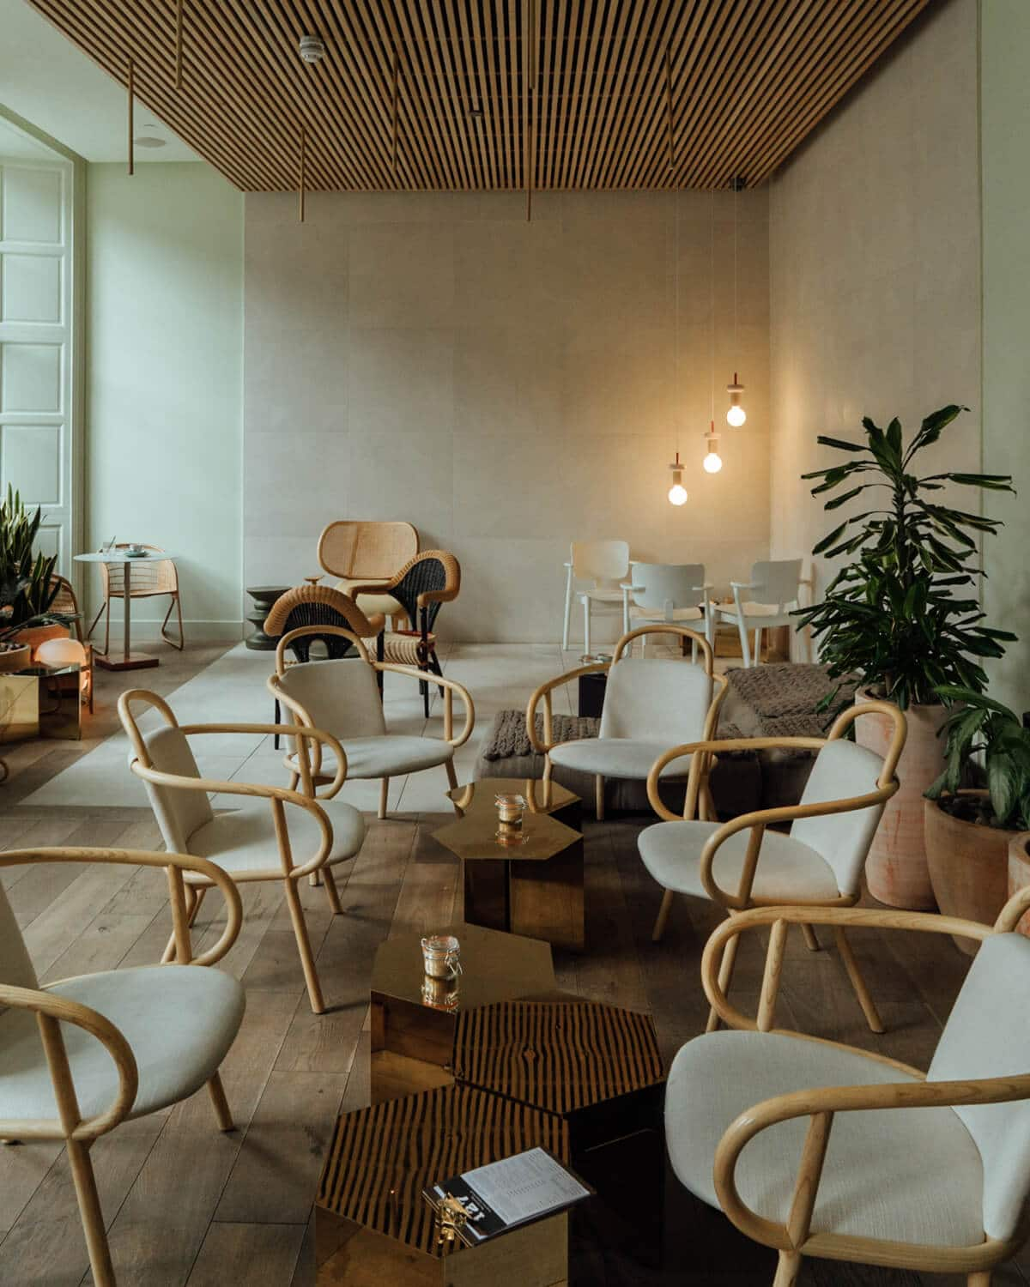
Critical analysis of the management theories
The event management theory will be considered in marketing this theme
The five Cs of the theory are concept, control, coordination, culmination and closeout
The concept of the considered theme is adding some features in Eden’s hospitality services
Notes:
The event management theory is considered in designing the thematic concept of Eden Locke since the five-step process is essential in marketing the newly introduced facilities to the new customers. The hotel is celebrating its five-year anniversary and hence it wishes to provide an enhanced hospitality experience to young couples.

Slide 10
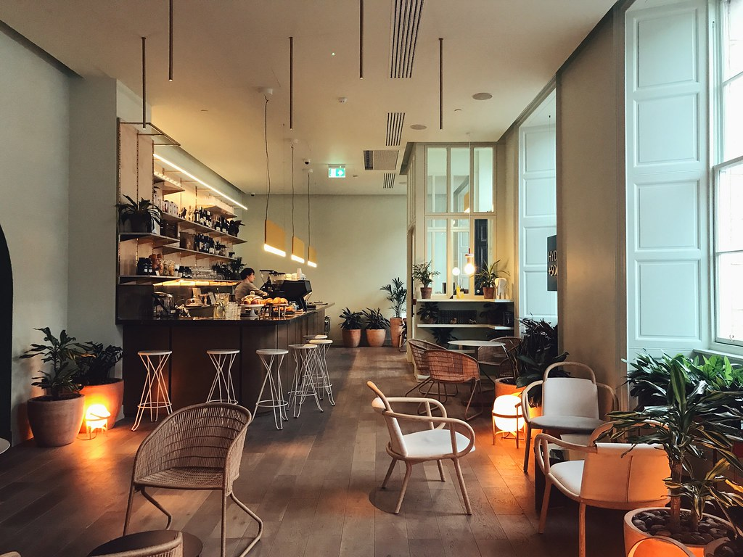
Critical analysis of the management theories CONTD
In addition to the above, there could be a discussion on Locke’s management on how to implement the new features
The tasks will be delegated to the team members as per their expertise
The third part of the theory is the control
Notes:
After deciding on the concept of the theme, there will be a discussion on how to divide responsibilities among the workers in implementing the project. The duties will be divided as per the expertise of Eden Locke’s workforce. Moreover, the third phase of the event management theory focuses on controlling the project which involves deciding the estimated time in bringing the thematic features into effect.

Slide 11
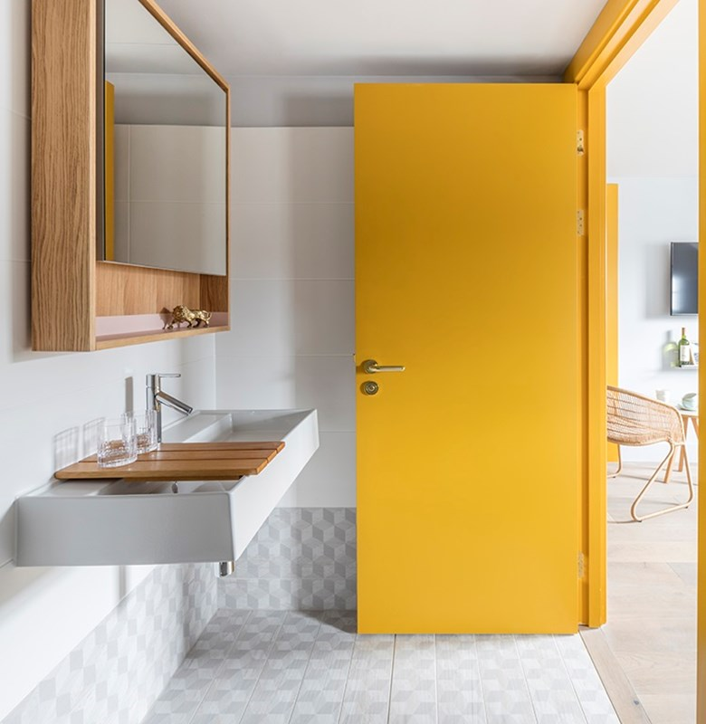
Critical analysis of the management theories contd..
The event management theory will be beneficial for this package introduced by Eden Locke.
For this theory, there are 7 key elements.
Notes:
It has been found that the event management theory can be beneficial for the package introduced by the hotel for celebrating its 5 years of success.

Slide 12
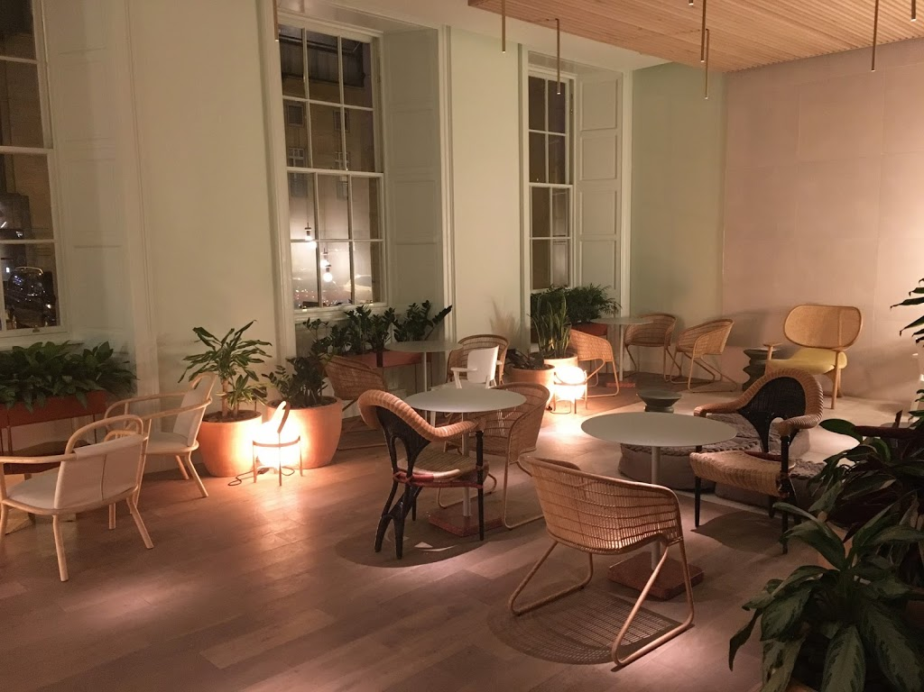
Critical analysis of the management theories contd..
The main key elements are audience and management.
Using this theory, this hotel can attract more international couple travellers
Notes:
It can also be found that there are 7 key elements such as audience and management. For this package, the target audience is international couples who love to travel.

Slide 13

Critical analysis of the experience design
Better involvement of technologies has developed its infrastructure and design
Better involvement of all the condition leads to satisfy the customers involvement
Better services presented leads to maintain better design and ore of customer attraction
Notes:
Technologies, all the condition and better service to customer leads improve sustainability and attract more customer.

Slide 14
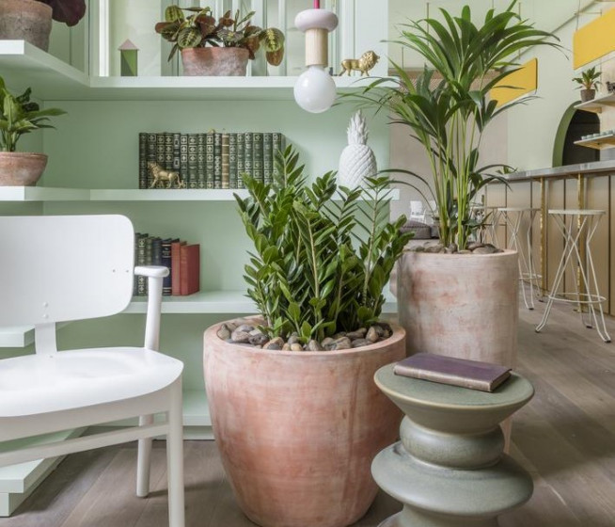
Critical analysis of the experience design contd..
Event management theory assist to understand the proper planning
It will help to fulfil the importance of customers
It assist increasing the marketing growth of this organisation
Notes:
The management team of this organstaion need to be follow event management theory to fulfill the goals of every consumers and in this way management will design their themes and implement proper planning to complete this theme.

Slide 15
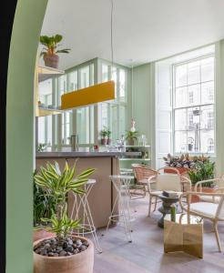
Critical analysis of the experience design contd..
The company is focusing on providing couples with a smooth travelling experience in the city.
The company is therefore using the vent management theory for promoting the deal.
Notes:
The management of this hotel is willing to give the couple a great travel experience so that the couple can remember this experience for the rest of their life. Therefore, the company is using this theory to promote its deal online.

Slide 16
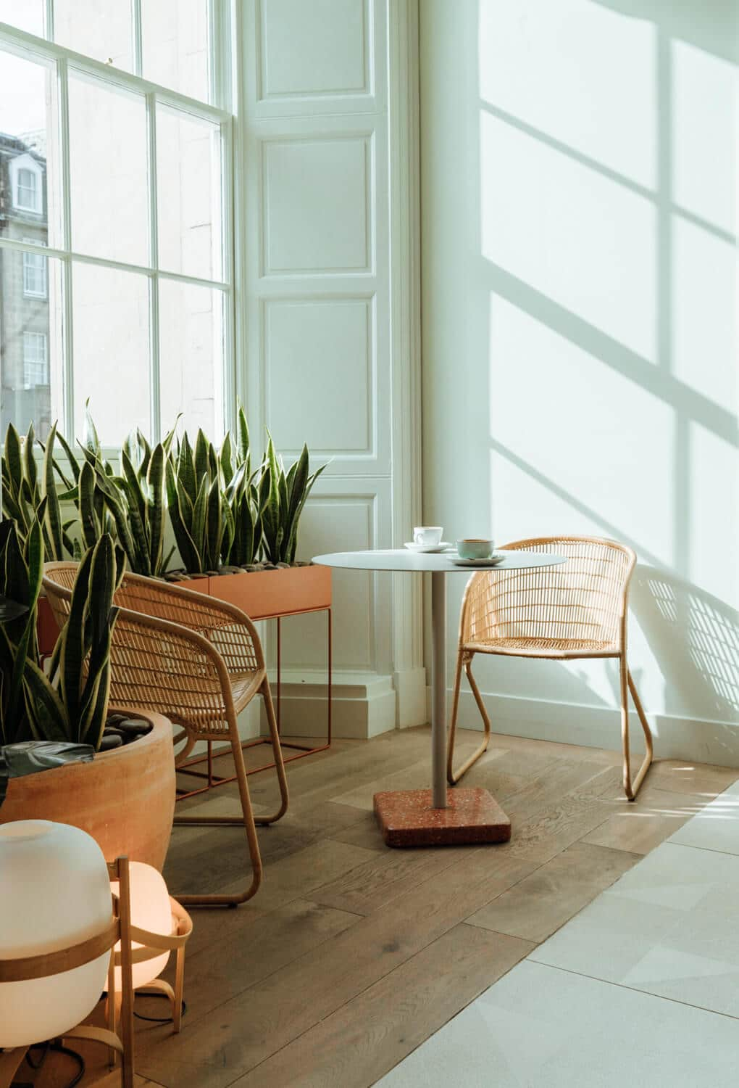
Critical analysis of the experience design contd..
Involving different patterns of design attracts more customer
Painting and lightning should be proper as per market analysis
Design of the walls should reflects any theme and also social eye catching
Notes:
Innovative design, painting and lightning and design of wall leads to involve and attract more of customer for the growth of hotel and industry.

Slide 17
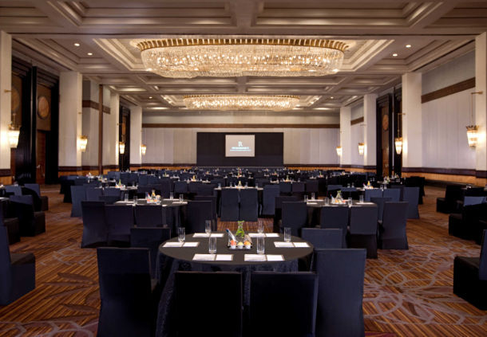
Critical analysis of the experience design contd..
Involving different patterns of design attracts more customer
Painting and lightning should be proper as per market analysis
Design of the walls should reflects any theme and also social eye catching
Notes:
Innovative design, painting and lightning and design of wall leads to involve and attract more of customer for the growth of hotel and industry.

Slide 18
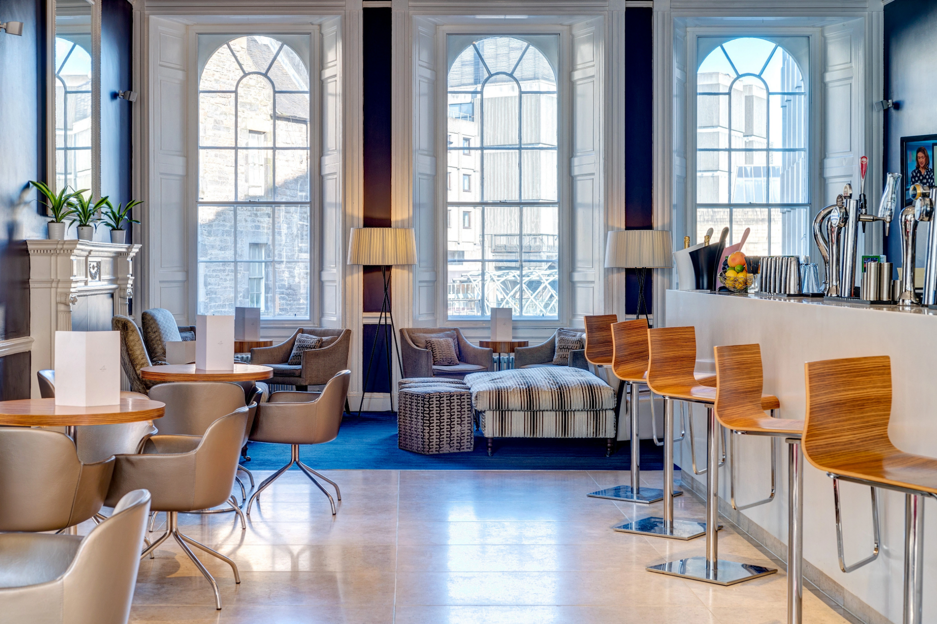
Analysis
More of the developed technologies that are involved in the hotel can be improved
Effective concern that can be determined with the hotels needs to be improved
Better travelling and staying of customers is a concern by the hotel for their attraction
Notes:
Technological development, effective communication and better customer experiences are involved in the advancement of the hotel infrastructure. This technology will; assist to impve the condictiuon of this event.

Slide 19
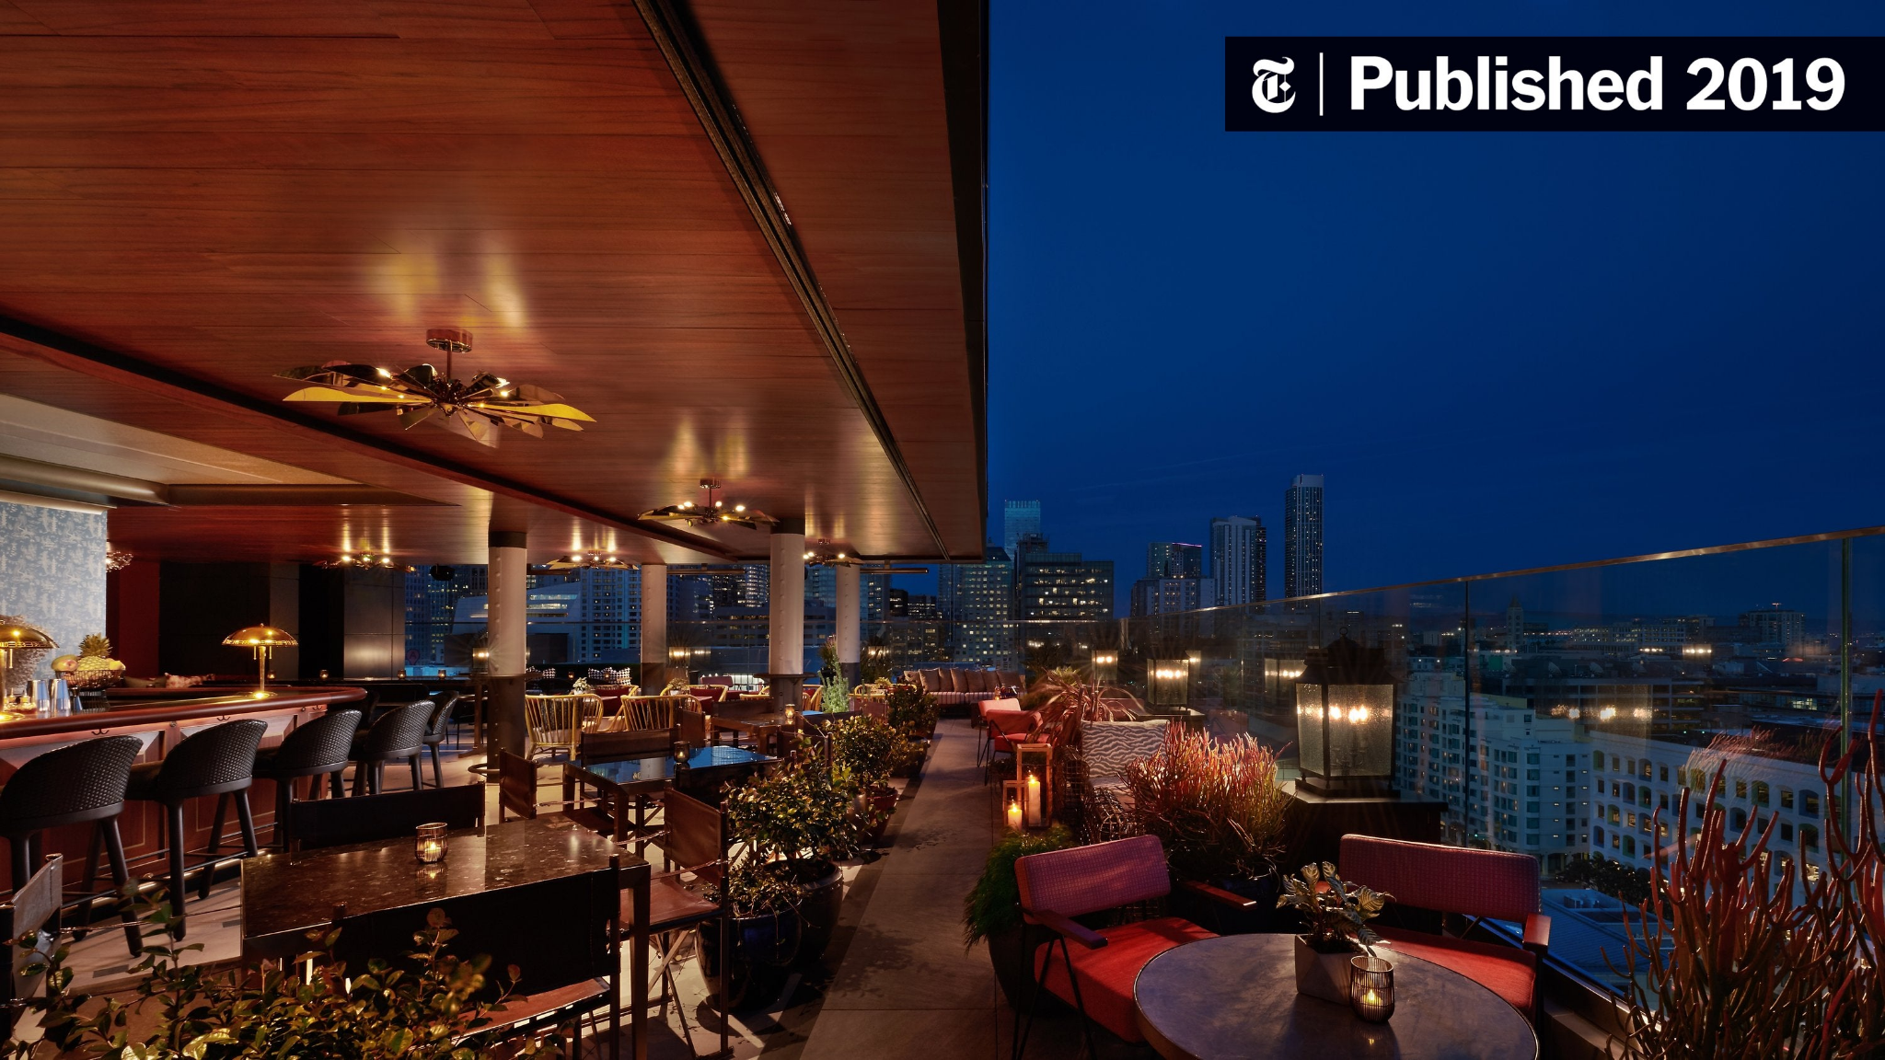
Conclusion
It can be concluded that developed infrastructure leads to involve for better hotel creation
More of better features that are involved in a hotel to make it effective for customers
Technologies should be involved to determine better work at the hotel
Notes:
From the above topic it can be concluded that increase in technologies can leads to improve the infrastructure of hotels and with better features of the hotel more of customer can be attracted from the features. Infrastructure as per the customer choice leads to improve brand image of hotel.

Slide 20
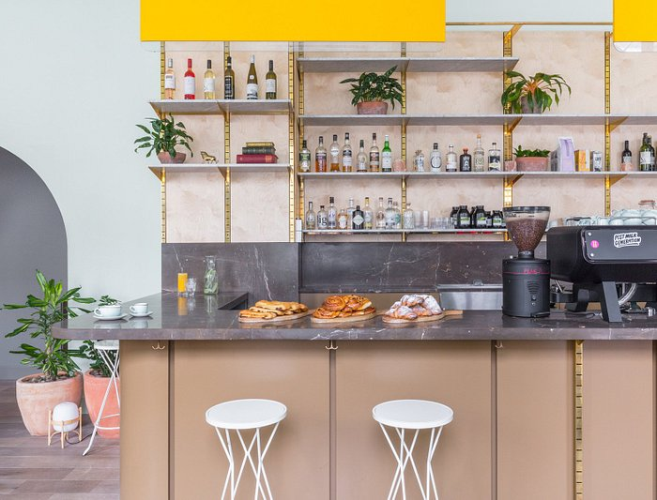
Recommendations
More of technologies leads to improve the infrastructure of the hotel
Increase in better lightning and infrastructure needs to be associated as it attract more customers
More of digital input needs to be managed to attract more customer with better services
Notes:
Technological advancement and use of technologies leads to improve the infrastructure of hotel and increase in better lightning that attract more of customer with fancy evolvement. Better service with digital inputs in the hotel needs to be implemented to attract more of customer and engage different potentiality.
In addition to this, another recommendation which can be provided to Eden Locke’s management is the event management theory may assist in enabling a five phase process in implementation of the theme since there is less chance of failure.

Slide 21
References
Getz, D. (2022). Event management. In Encyclopedia of Tourism Management and Marketing (pp. 144-147). Edward Elgar Publishing. Retrieved from:https://doi.org/10.4337/9781800377486.event.management
Xia, H., Vu, H. Q., Law, R., & Li, G. (2020). Evaluation of hotel brand competitiveness based on hotel features ratings. International Journal of Hospitality Management, 86, 102366. Retrieved from:https://doi.org/10.1016/j.ijhm.2019.102366
Ivanov, S., Seyitoğlu, F., & Markova, M. (2020). Hotel managers’ perceptions towards the use of robots: a mixed-methods approach. Information Technology & Tourism, 22, 505-535. Retrieved from:https://dl.acm.org/doi/abs/10.1145/3341162.3350843
Filimonau, V., Derqui, B., & Matute, J. (2020). The COVID-19 pandemic and organisational commitment of senior hotel managers. International Journal of Hospitality Management, 91, 102659. Retrieved from:https://doi.org/10.1016/j.tourman.2021.104395
Liu, S., Gao, B., Gallivan, M., & Gong, Y. (2020). Free add-on services and perceived value in competitive environments: Evidence from online hotel reviews. International journal of hospitality management, 90, 102611. Retrieved from:https://doi.org/10.1016/j.ijhm.2020.102611
Varsanis, K., Belias, D., Kakkos, N., Chondrogiannis, M., Rossidis, I., & Mantas, C. (2019). The relationship between service quality and customer satisfaction on luxurious hotels so to produce error-free service. In Strategic Innovative Marketing and Tourism: 7th ICSIMAT, Athenian Riviera, Greece, 2018 (pp. 67-76). Springer International Publishing. Retrieved from: https://doi.org/10.1007/978-3-030-12453-3_8
Lockeliving.com, 2023. Retrieved from:https://www.lockeliving.com/en/edinburgh/eden-locke

Slide 22


